Slide 1
DIGITAL CORE
SOFTWARE & PLATFORM ENGINEERING UPDATE
Digital Core Exco, May 2026

Slide 2
S&PE UPDATE:
  MARKET OPPORTUNITY
  OFFERINGS
  BUSINESS IMPACT

Slide 3

SOFTWARE & PLATFORM ENGINEERING MARKET OPPORTUNITY
The Rise of Custom Software & SDLC
AI is collapsing the cost and time of building software — creating the single biggest shift in how enterprises design, build, and operate custom applications. The window to lead is now.
SIGNAL 01
SIGNAL 02
SIGNAL 03
The AI-Native Build Era Has Arrived
SDLC Is Being Reinvented End-to-End
Legacy Modernization Window Is Closing
"What took 3 years and $50M now ships in 9 months — AI agents do the heavy lifting."
"Every stage of the software lifecycle — from requirements to deployment — is being rewritten."
"You can't AI-enable a foundation that wasn't built for AI. The window to retrofit is now."
10× faster delivery cycles emerging across early adopters.
AI SDLC Transformation now a boardroom priority.
Application Modernization demand surging
OPPORTUNITY
WHY ACT NOW
New Business Growth Across Every Vertical
First-Mover Advantage in Client Transformation
"AI-native engineering is not a feature upgrade — it is a full business model reset for every client."
"Clients who transform their engineering model in 2025-26 will outpace competitors for the decade ahead."
Greenfield AI-native custom application development
Companies are shifting from SaaS and packaged solutions to custom-built solutions
Agentic architecture & AIOps rapidly becoming standard
Clients seeking a trusted transformation partner

Slide 4
SOFTWARE & PLATFORM ENGINEERING PORTFOLIO OVERVIEW
Five Offerings. One Reinvention.
Each offering targets a different layer of the software lifecycle — together they form a complete transformation platform.
OFFERING 01
OFFERING 02
OFFERING 03
Frictionless SDLC
High Velocity Modernization
AI Native Custom Engineering
Enabling your teams to ship 2x more without hiring a single extra person
What used to take 3 years and $50M now takes 9 months. AI agents do the heavy lifting.
This isn't how we used to build custom software and products. The old model is over.
OFFERING 04
OFFERING 05
S&PE Managed Services
SW Architecture Foundation
"We build and support systems that build and fix themselves — powered by AI."
"You can't AI-enable a foundation that wasn't built for AI. We design the one that is."
Copyright © 2026 Accenture. All rights reserved. | Material, Non-Public - Not To Be Distributed Further

Slide 5
S&PE OFFERINGS:
FRICTIONLESS SDLC

Slide 6
SOFTWARE & PLATFORM ENGINEERING PORTFOLIO OVERVIEW
Frictionless SDLC
OFFERING 01
OFFERING 02
OFFERING 03
OFFERING 04
OFFERING 05
Frictionless SDLC
High Velocity Modernization
AI Native Custom Engineering
S&PE Managed Services
SW Architecture Foundation
▼
▼
▼
▼
▼
Frictionless SDLC Is the Key to all of the Offerings
This is how we reinvent how
clients build software.
✕
Not just another offering
⊙
The basis of every delivery
⊕
Standalone or embedded
The operating model transformation layer
Underpins all five offerings above
The entry point to every transformation
Copyright © 2026 Accenture. All rights reserved. | Material, Non-Public - Not To Be Distributed Further

Slide 7
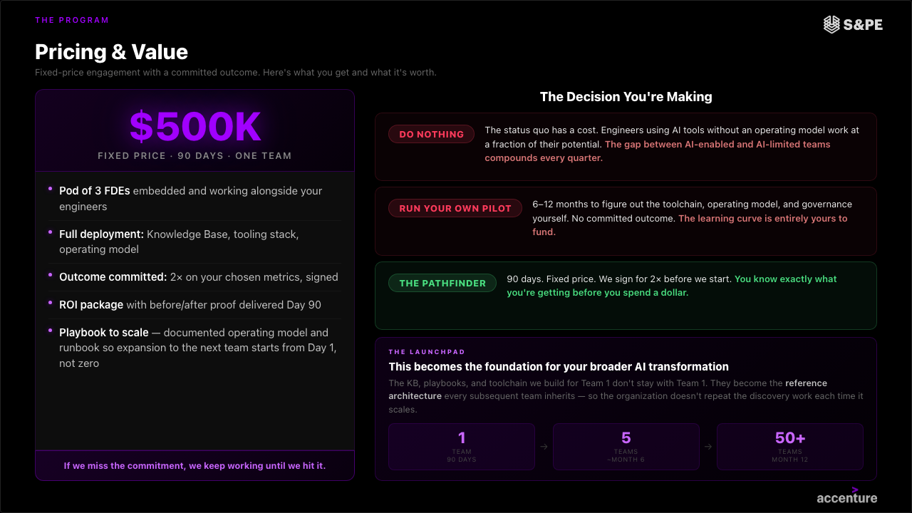
SOFTWARE & PLATFORM ENGINEERING PORTFOLIO OVERVIEW
Frictionless SDLC – How we double a Team Productivity in 90 days
Copyright © 2026 Accenture. All rights reserved. | Material, Non-Public - Not To Be Distributed Further

Slide 8
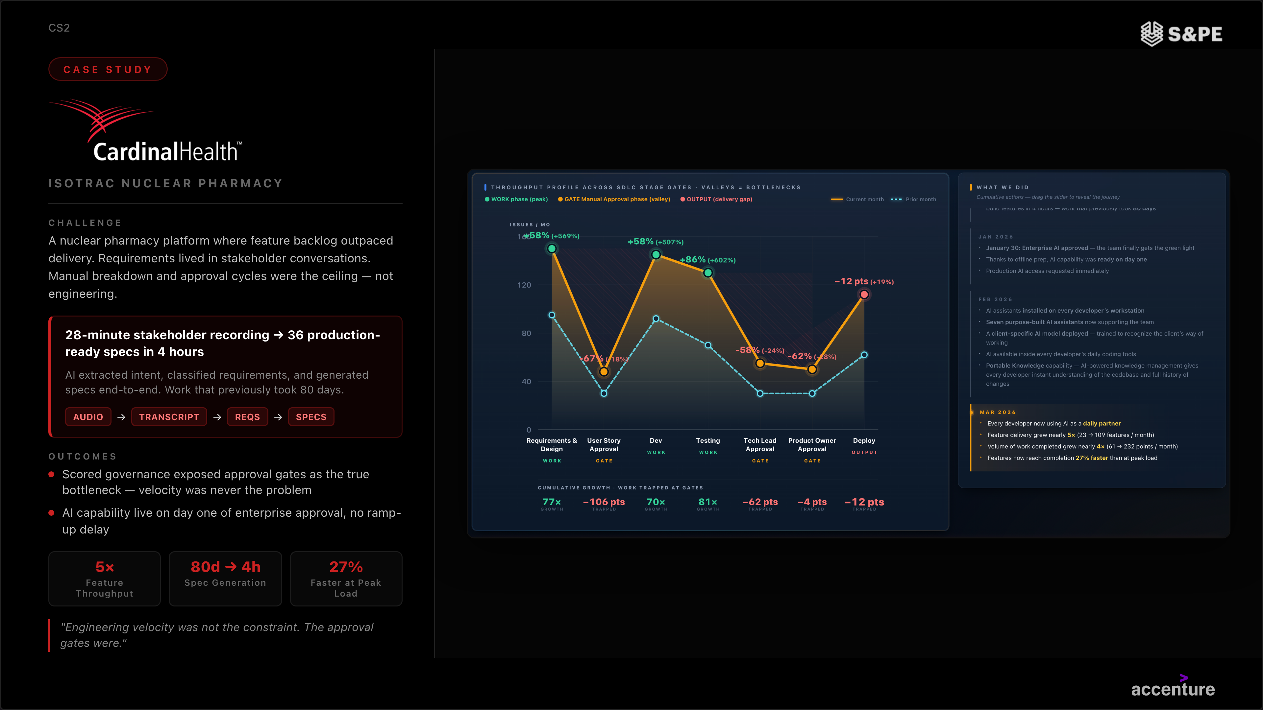
SOFTWARE & PLATFORM ENGINEERING PORTFOLIO OVERVIEW
Frictionless SDLC & Legacy Modernization Example
Copyright © 2026 Accenture. All rights reserved. | Material, Non-Public - Not To Be Distributed Further

Slide 9
S&PE OFFERINGS:
HIGH VELOCITY MODERNIZATION

Slide 10
SOFTWARE & PLATFORM ENGINEERING PORTFOLIO OVERVIEW
High Velocity Modernization
"What used to take 3 years and $50M now takes 9 months. AI
agents do the heavy lifting."
Application Modernization
AI agents analyze your entire codebase, generate refactoring blueprints, and execute migrations at a scale and speed no human team can match. What traditionally took 2–3 years of expensive manual effort now takes months with lower risk and built-in validation at every step.
Traditional modernization is slow, expensive, and risky. We do it differently. AI agents analyze your entire legacy estate, generate migration blueprints, convert code, and validate output autonomously and at scale. What teams once spent years manually refactoring, our AI-powered approach handles in months. Clients reach cloud-native faster, cheaper, and with dramatically less execution risk than any traditional approach.
Mainframe Modernization
Our AI-powered approach ingests COBOL, RPG, or Assembler, maps business logic, generates cloud-native equivalents, and validates output automatically. Clients who assumed mainframe migration would take a decade are completing it in under 18 months.
WHY NOW
Every month your legacy systems run, they cost more, move slower, and fall further behind. AI has fundamentally changed the economics of modernization. The window to transform at a fraction of traditional cost is open but it won't stay open forever

Slide 11

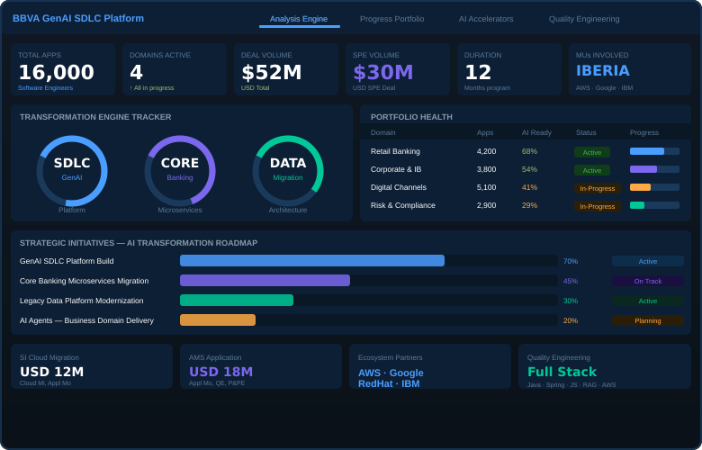
SOFTWARE & PLATFORM ENGINEERING PORTFOLIO OVERVIEW
High Velocity Modernization (and SLDC, Architecture) Example
ENTERPRISE MODERNIZATION
CHALLENGE
BBVA is a global banking group at the forefront of banking innovation, investing heavily in cloud, digital, data and AI. With 16,000+ software engineers, BBVA is partnering with Accenture to accelerate time to market, reduce costs, and transform the SDLC using GenAI — from requirements gathering to production.
APPROACH
GenAI SDLC Platform built to standardize quality & efficiency for 16,000 engineers
Core Banking migrated to new microservices architecture at scale
Legacy apps & data platforms modernized via GenAI across all domains
AI agents applied to accelerate delivery across all business domains
50–70%
USD 52M
12 mo
Autonomous
Total Deal
Duration
"Transforming the SDLC to a GenAI SDLC. Doing this by building the GenAI SDLC Platform to standardize, gain quality and efficiency for more than 16,000 software engineers."

Slide 12
S&PE OFFERINGS:
AI NATIVE CUSTOM ENGINEERING

Slide 13
SOFTWARE & PLATFORM ENGINEERING PORTFOLIO OVERVIEW
AI Native Custom Engineering
SOLUTIONS
Custom Application Development
Net-new apps and AI agents in weeks, not months. AI-native from line one. Built to last.
"This isn't how we used to build custom software. The old model
big teams, long timelines, unpredictable costs is over."
Product & Platform Engineering
We own your product end-to-end — from strategy and design to build and launch. AI co-authors the code, generates tests, and catches issues before they ship. Your product, fully delivered, AI-native from day one.
AI doesn't just speed up our engineers it changes what's possible. From first design decision to production, AI agents co-author code, generate tests, flag issues, and optimize performance in real time. We deliver custom applications, platforms, and AI agents in half the time at a fraction of the cost of traditional development without sacrificing quality or scalability.
Silicon Engineering
Purpose-built silicon for AI inference and training. AI workloads run faster and cheaper from the chip up.
SaaS/Package Replacement
Replace off-the-shelf tools with AI-native custom alternatives. Eliminate licensing costs, vendor lock-in, and the customization tax.
WHY NOW
Traditional software development is becoming obsolete. Organizations building AI-native today ship 2x faster at a fraction of the cost. Those still running traditional delivery are competing with one hand tied behind their back.
Quality Engineering
Transform quality into a strategic capability—driving efficiency, reducing risk, and ensuring consistent, customer-centric outcomes in increasingly complex, AI-driven systems tools with AI-native custom alternatives.

Slide 14
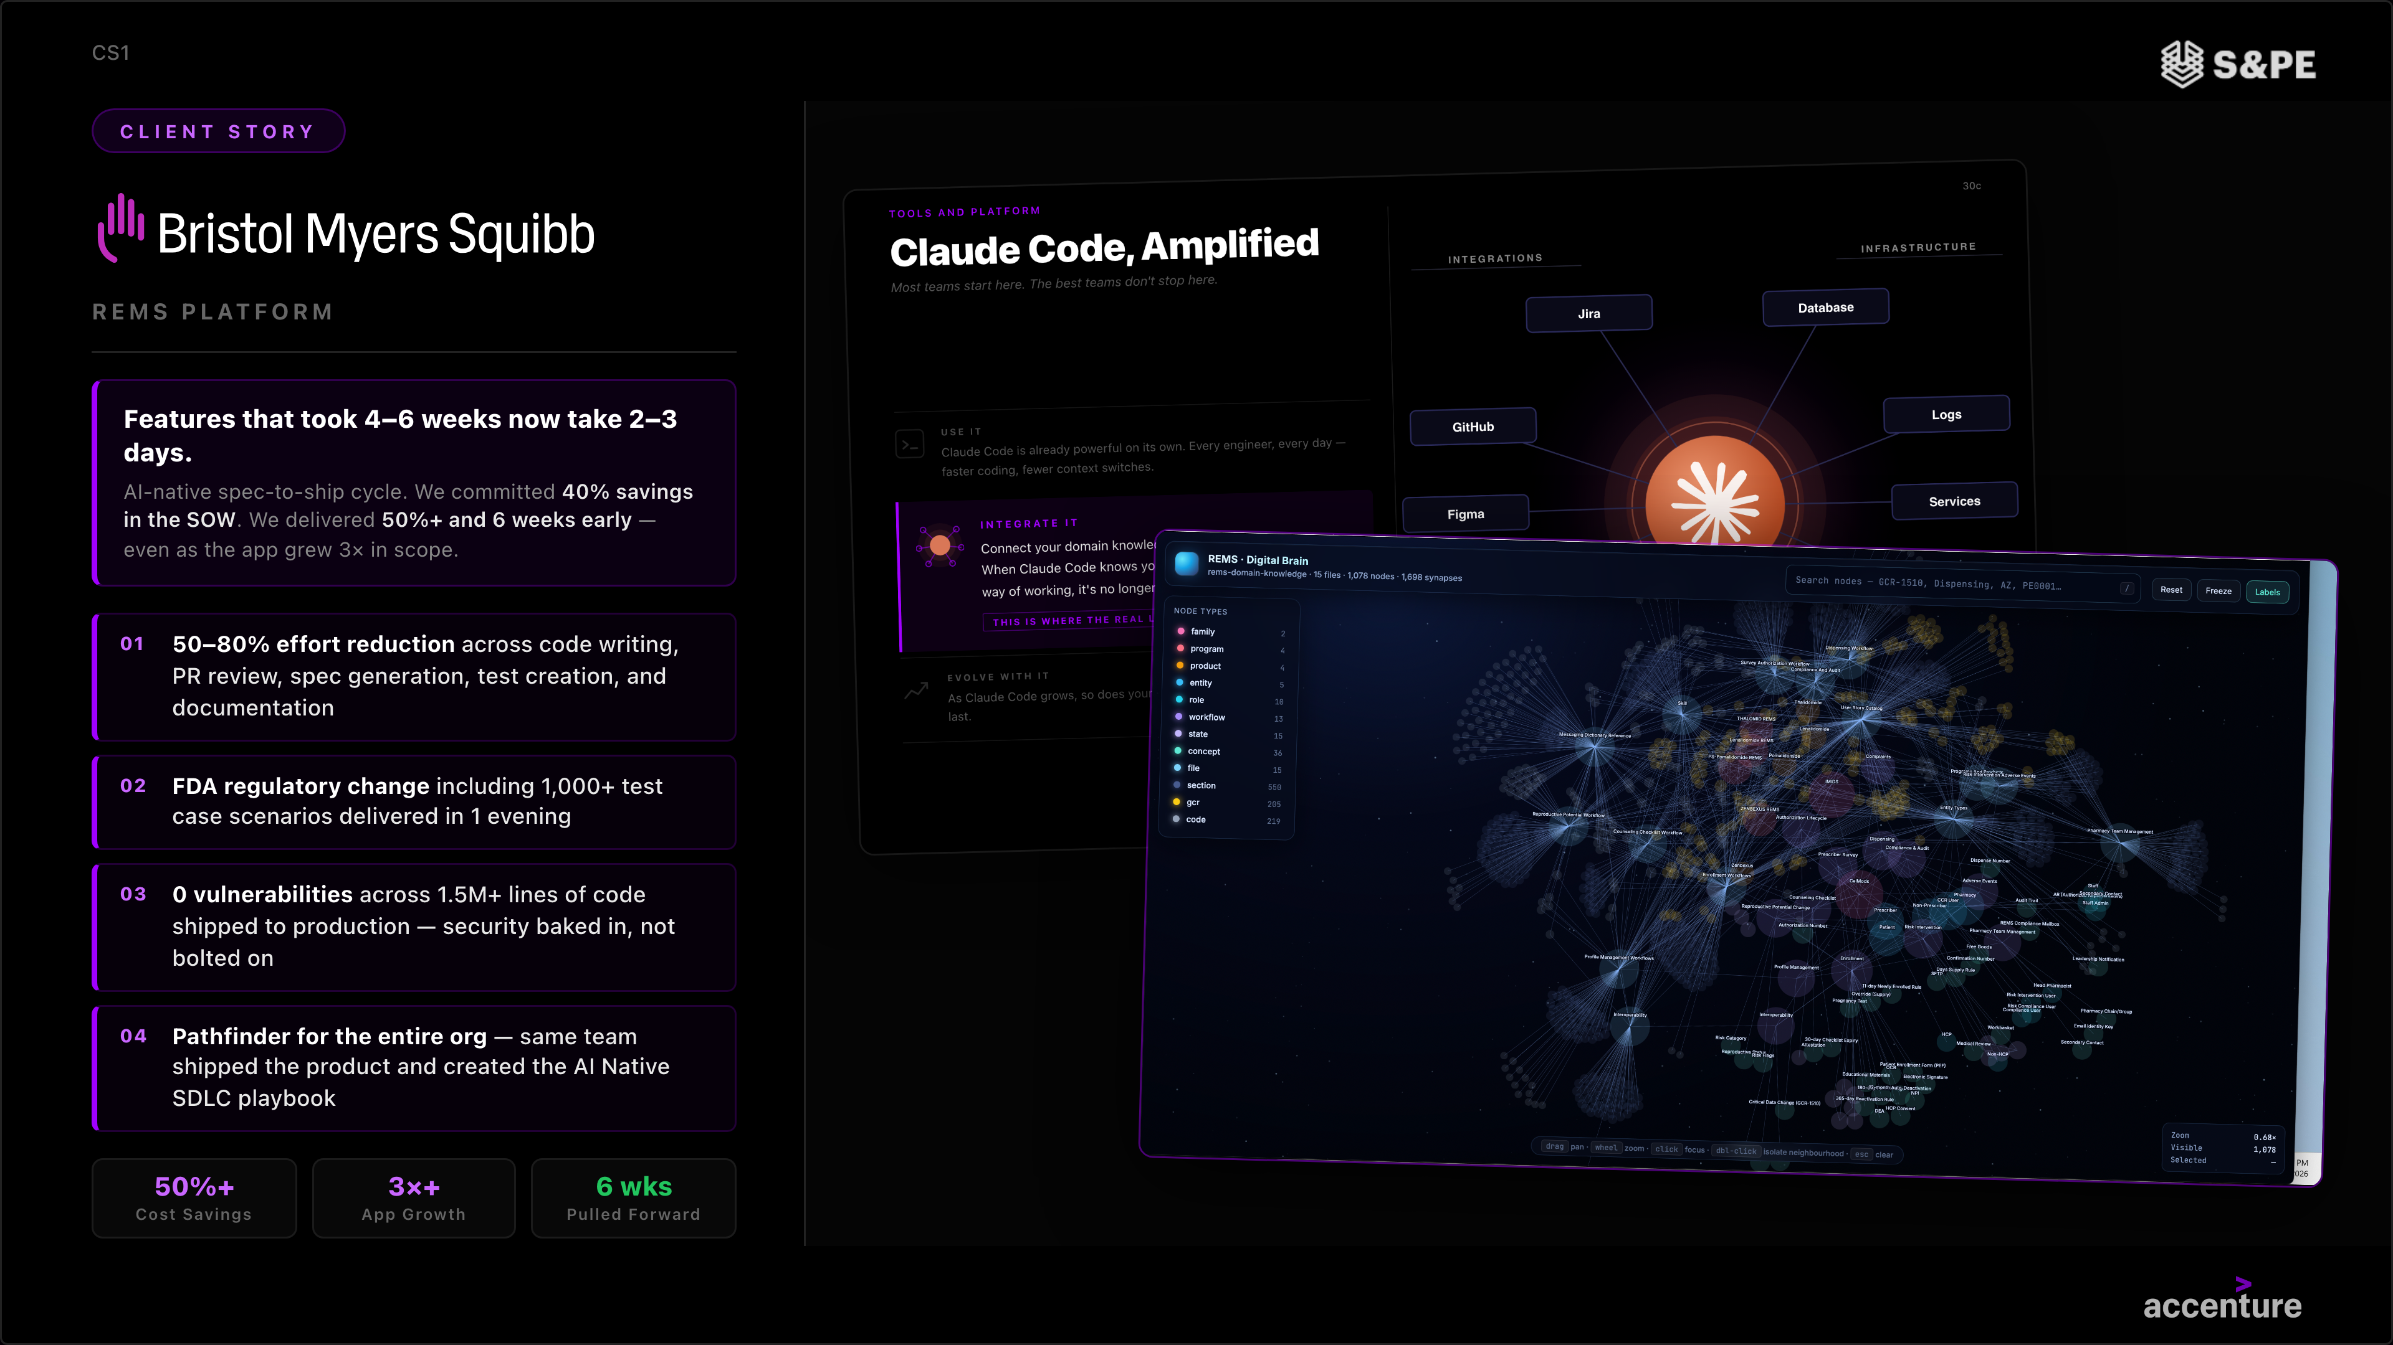
SOFTWARE & PLATFORM ENGINEERING PORTFOLIO OVERVIEW
AI Native Custom Engineering (and SDLC) Example
Copyright © 2026 Accenture. All rights reserved. | Material, Non-Public - Not To Be Distributed Further

Slide 15
S&PE OFFERINGS:
S&PE MANAGED SERVICES

Slide 16
SOFTWARE & PLATFORM ENGINEERING PORTFOLIO OVERVIEW
S&PE Managed Services - Types
We don't build and leave. Once we build or modernize, we stay — operating and continuously improving the systems we create.
That ongoing relationship delivers two distinct value streams:
RUN THE BUSINESS
focus on Operational Continuity
Ensure stability, compliance, and uptime
Incident response & break-fix resolution
SLA-driven, availability-focused
Reactive model with cost-optimization focus
Measured by MTTR, availability, reliability
→ Delivered via Digital Core Managed Services Offering
CHANGE THE BUSINESS
focus on AI-Powered Evolution
Continuously improve, evolve, and deliver new value
AI-driven feature enhancements & UX optimization
Insight-driven demand, not just backlog-driven
Velocity, quality, and continuous learning at scale
→ S&PE Managed Services Offering
The AI era demands a fundamentally different operating model — one where every enhancement cycle is AI-powered, insight-driven, and self-improving. We call it the Enhancement Engine.

Slide 17
SOFTWARE & PLATFORM ENGINEERING PORTFOLIO OVERVIEW
S&PE Managed Services Offerings
Five offerings, one AI-native Enhancement Engine - delivering outcomes that are cheaper, faster, and better
Custom Application Development Managed Services
Mainframe Application Managed Services
Product & Platform Managed Services
Silicon Engineering Managed Services
Quality Engineering Managed Services
Enhance and extend custom applications through AI-accelerated development, intelligent code generation, and automated quality assurance.
AI-prioritized backlog & demand sensing
AI-assisted code remediation & feature builds
Automated regression testing
Extend mainframe applications with AI-driven code conversion, automated refactoring, and accelerated cloud-native development.
AI impact analysis for legacy modernization
AI-assisted development
Auto-generated migration test suites
Accelerate product and platform feature extension with AI-driven development, intelligent backlog prioritization, and rapid prototyping.
Insights-driven feature prioritization
AI-assisted platform code delivery
Continuous integration & release automation
Enhance silicon toolchains, firmware, and driver software with AI-assisted coding, automated validation, and rapid iteration.
AI impact analysis for firmware & drivers
AI-assisted firmware development
Automated validation & perf testing
Embed quality into every development sprint with AI-generated test suites, intelligent code review, and shift-left defect prevention.
AI-generated test suites & coverage
Intelligent defect prediction & triage
Shift-left quality gates & code analysis
CHEAPER
Lower cost per enhancement through AI-augmented delivery
FASTER
Accelerated sprint velocity with AI across the SDLC
BETTER
Higher quality through AI-generated testing & continuous learning

Slide 18
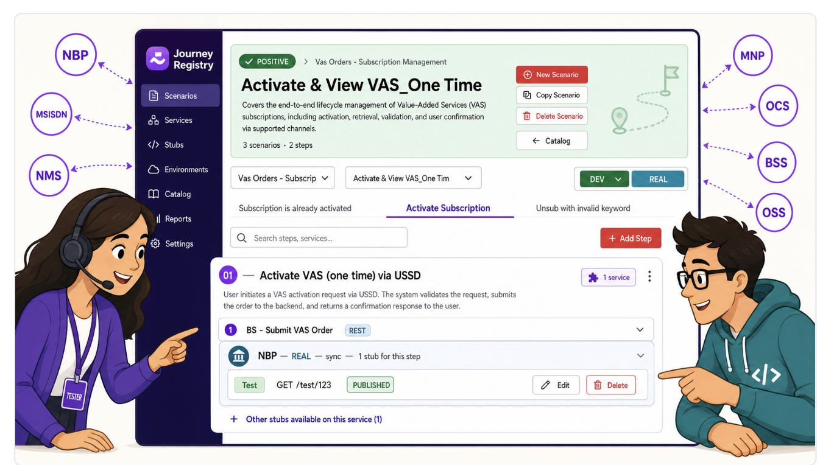
SOFTWARE & PLATFORM ENGINEERING PORTFOLIO OVERVIEW
S&PE Managed Services Example
Indonesia's largest Telco operator
CHALLENGE
Growing business demand & technical complexity require new way of working. Majority of time & effort in change request delivery was consumed by manual quality and testing work — adding more people was not the answer.
WHAT WE DID
Proved AI could take on repetitive engineering work, freeing senior talent for higher-value design
Built a unified intelligence layer that makes engineering knowledge AI-ready and reusable
Modernized the testing engine — from manual end-stage checks to continuous, automated quality
✦
◆
●
Higher throughput
Quality over delivery
Flexibility
OUTCOME
Same engineers, same budget — more business outcomes delivered every cycle
Growth in knowledge context & more artefact will improve AI Context for better quality
Scalable solutions for agile market adaptation
"Same team. Higher velocity. Reusability of knowledge & artefact for future releases."

Slide 19
S&PE OFFERINGS:
SOFTWARE ARCHITECTURE FOUNDATION

Slide 20
SOFTWARE & PLATFORM ENGINEERING PORTFOLIO OVERVIEW
Software Architecture Foundation
Enterprise Architecture
We assess and blueprint your full technology estate, identify the gaps between where you are and where AI-native operations require you to be, and build a prioritized, investment-ready roadmap. Every modernization dollar pointed in the right direction from day one.
"You can't AI-enable a foundation that wasn't built for AI. We
design the one that is."
Technology Architecture
We design modern, scalable architectures purpose-built for cloud, AI workloads, and autonomous operations removing complexity instead of adding to it. Designed for what you need in three years, not just today.
Every failed AI initiative can be traced back to architecture that wasn't ready for it. We design enterprise, technology, and agentic architectures from the ground up for AI workloads, AI agents, and autonomous operations. No retrofitting. No re-engineering 18 months from now. Just a foundation that makes every AI investment work and compound over time.
Agentic Architecture
Deploying AI agents at enterprise scale requires architecture most organizations haven't designed for orchestration layers, memory systems, guardrails, and governance. We design the infrastructure that makes agentic AI work safely in production, not just in demos.
WHY NOW
Organizations rushing to deploy AI without the right architecture end up rebuilding from scratch. Getting architecture right first is the difference between AI investments that scale and experiments that plateau. This is what makes everything else faster and cheaper.
Digitally Resilient & Sovereign Architecture
AI-driven resilience by design — not bolt-on. We architect systems that anticipate failure, self-heal autonomously, and maintain continuity under stress. Cyber recovery, fault-tolerant design, and AI-monitored threat posture built into the foundation from the start, taking into account Sovereignty constraints.
“Don’t let Architecture happen. Make it happen"

Slide 21
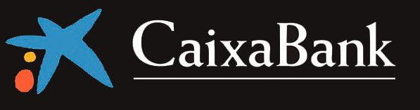
SOFTWARE & PLATFORM ENGINEERING PORTFOLIO OVERVIEW
Software Architecture Foundation
(and Custom Engineering, Modernization) Example
ENTERPRISE CHALLENGE
The Goal
A top European financial institution started a multi-year program (2025-2030) to modernize banking, operations, and technology, addressing outdated systems, low automation, slow product launches, high costs, and regulatory demands—all while keeping the business running smoothly.
Drive significant improvements in business agility and operations by building a digital-ready core with hybrid cloud, expanding data, AI, and GenAI use, redesigning operating models for efficiency and compliance, and enhancing skills and innovation—all through a long-term strategic partnership.
Target savings
33%
in development and maintenance costs
40%
in operations
20%
in call center / remote management
WHAT ACCENTURE DID
Accenture was chosen as a strategic transformation partner, integrating Strategy & Consulting, Technology, and AI-led delivery.
We developed a comprehensive transformation plan, launched an AI-driven platform, modernized core systems, embedded advanced technologies like GenAI and cloud-native architectures, deployed a senior multidisciplinary team, and introduced an innovation funding model to support ongoing development.
Expected business outcomes
Time to Market: Faster product launches for a competitive edge
Customization: Tailored customer experiences to boost satisfaction
Flexibility: Scalable solutions for agile market adaptation
"Reinventing a Tier‑1 Financial Institution Through Enterprise‑Scale AI‑Led Transformation."

Slide 22
S&PE BUSINESS IMPACT

Slide 23











SOFTWARE & PLATFORM ENGINEERING BUSINESS IMPACT
Other Recent Software & Platform Engineering Highlights
Key Deals across the Markets brining together our offerings
$45M – RDE Powered
Custom Engineering &
Managed Services
$81M – AI-powered App Custom Engineering &
Managed Services
$126M – RDE Powered Architecture, Custom Engineering &
Managed Services
$32M (total) – RDE Powered Custom Engineering; Follow on $60-70m in FY27
Restricted
(Australian Transport)
$162M Business Transformation – Architecture, SDLC, Custom Engineering
$63M – Modernization
$5Mn SDLC, Modernization, Custom
Engineering
$16M – Modernization
$47M – RDE Powered Modernization
$33.3M –
Modernization
$74.8M – Modernization, Custom Engineering & Managed Services
$67M – Custom Engineering

Slide 24
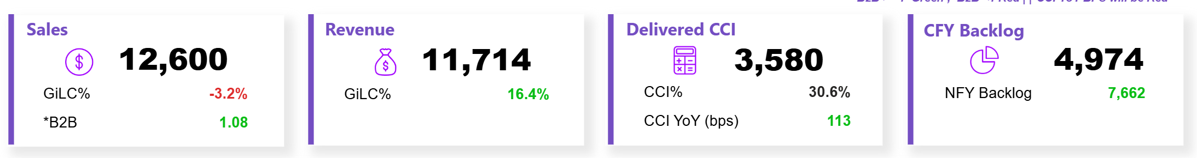
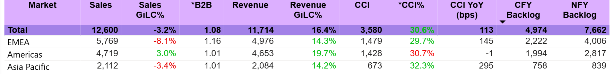
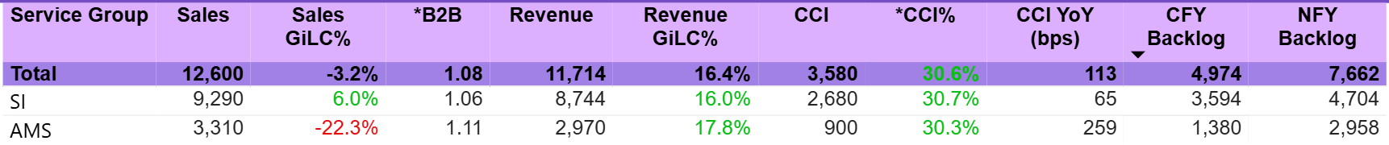
SOFTWARE & PLATFORM ENGINEERING BUSINESS IMPACT
Business Summary – April YTD
S&PE Global
By Market
By Service Group

Slide 25
SOFTWARE & PLATFORM ENGINEERING BUSINESS IMPACT
In Summary
Frictionless SDLC
Enabling your teams to ship 2x more without hiring a single extra person
AI is collapsing the cost and time of building software — creating the single biggest shift in how enterprises design, build, and operate custom applications.
AI-native engineering is the new standard for application and platform development , enabling faster delivery, embedded quality, and lower-cost operations – S&PE is driving this transformation.
High Velocity Modernization
What used to take 3 years and $50M now takes 9 months. AI agents do the heavy lifting.
AI Native Custom Engineering
Every business is a software business, and S&PE is reinventing our clients’ businesses
  rapidly modernizing existing systems and creating new ones implementing highly differentiated and truly innovative business capabilities via it five AI-native offerings
This isn't how we used to build custom software and products. The old model is over.
S&PE Managed Services
"We build and support systems that build and fix themselves — powered by AI."
SW Architecture Foundation
"You can't AI-enable a foundation that wasn't built for AI. We design the one that is."

Slide 26
THANK YOU

Slide 27
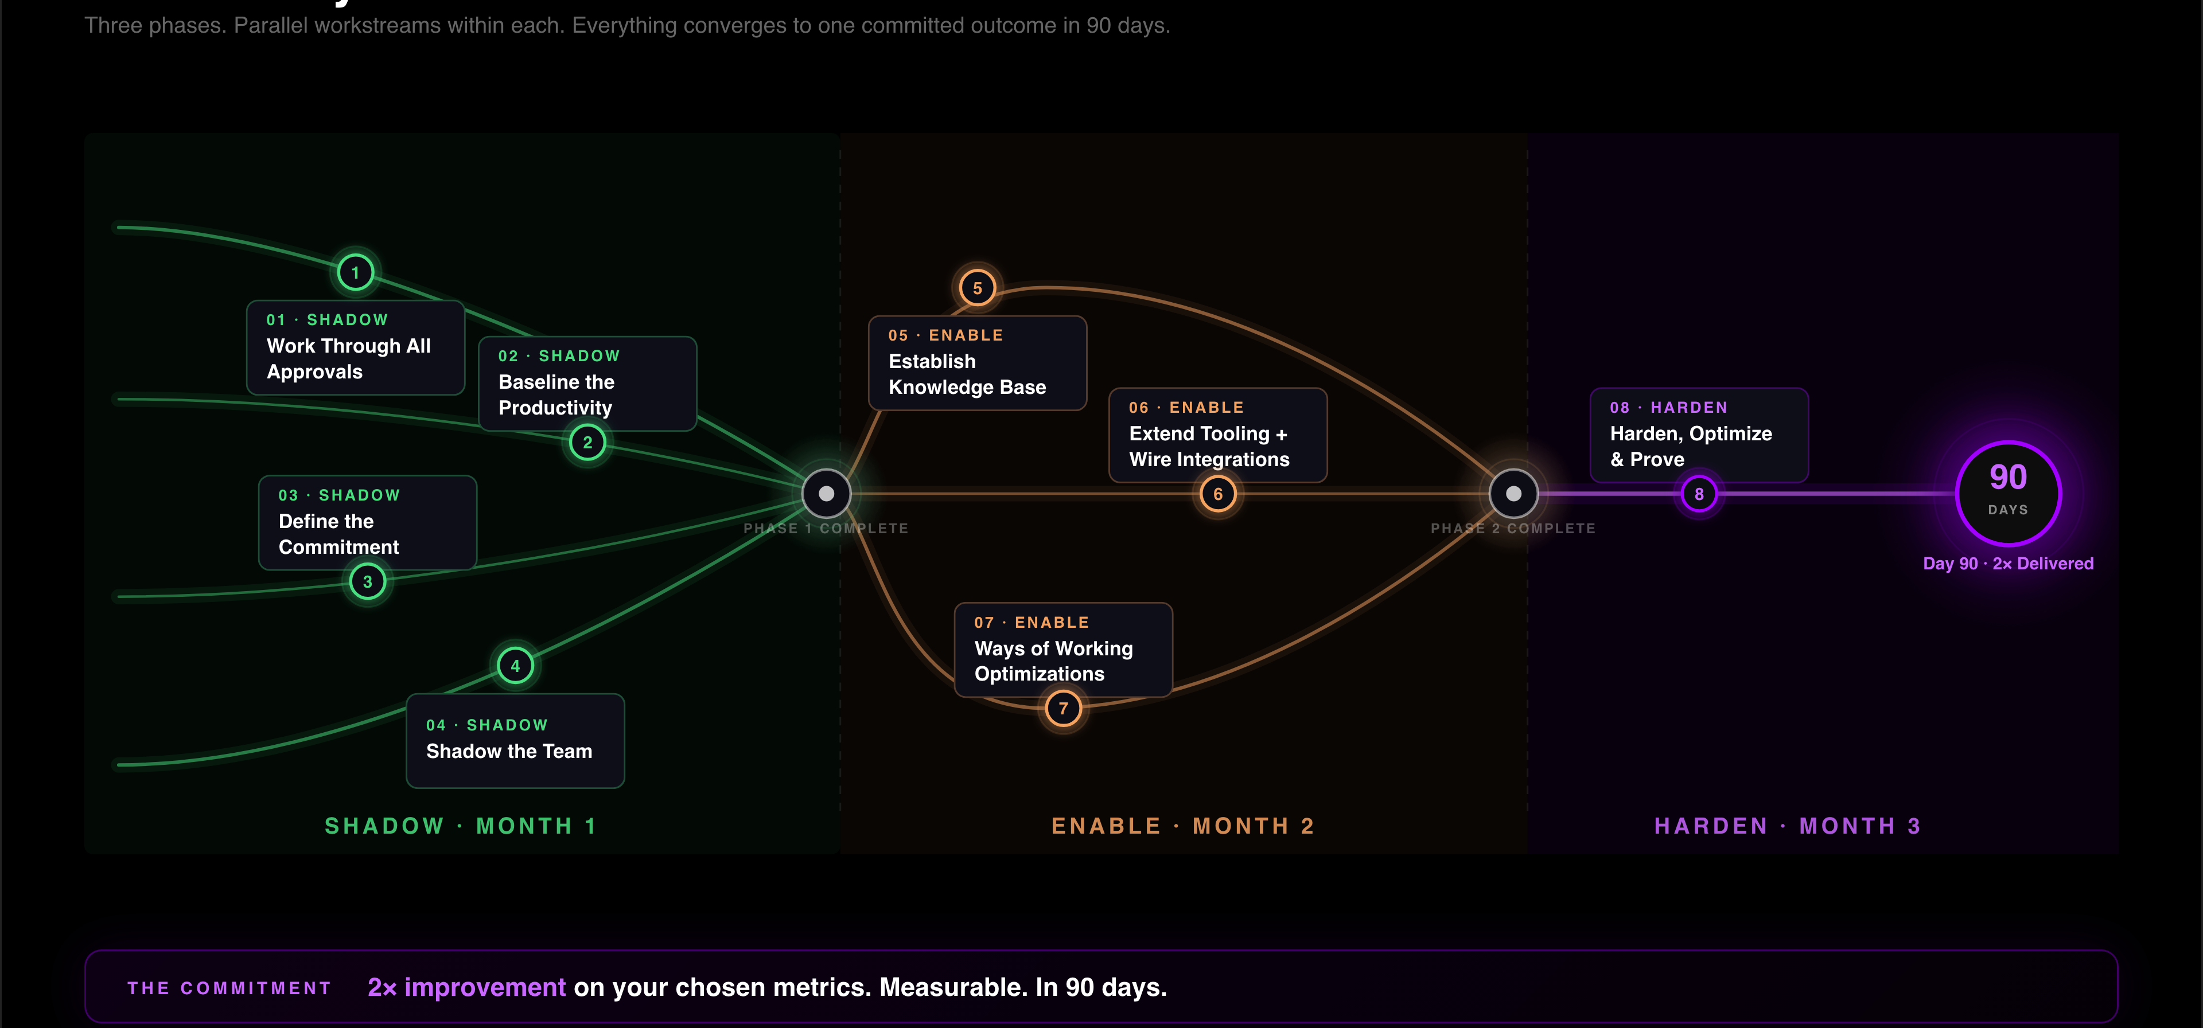
SOFTWARE & PLATFORM ENGINEERING PORTFOLIO OVERVIEW
Frictionless SDLC – How we double a Team Productivity in 90 days
Copyright © 2026 Accenture. All rights reserved. | Material, Non-Public - Not To Be Distributed Further

Slide 28
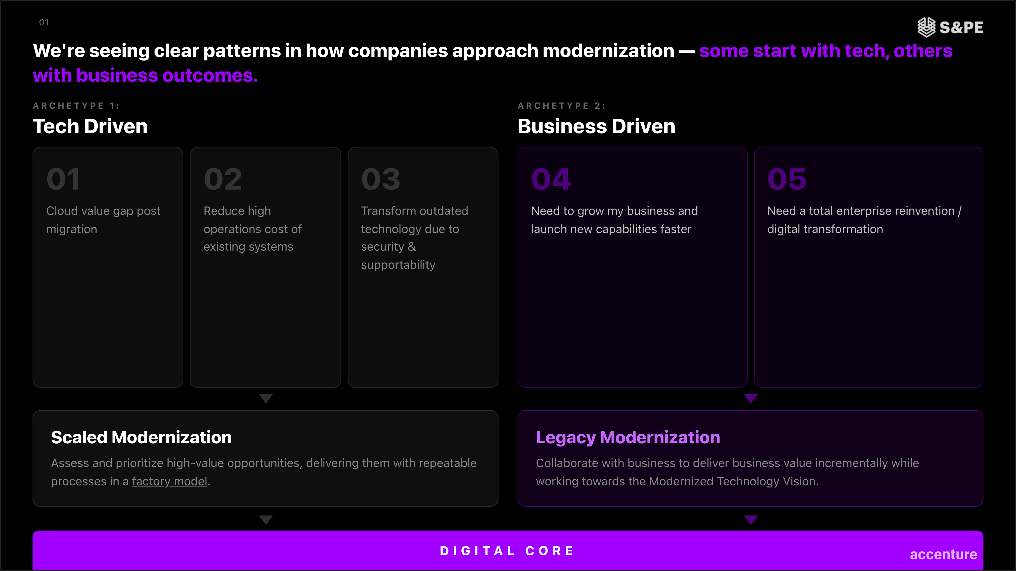
SOFTWARE & PLATFORM ENGINEERING PORTFOLIO OVERVIEW
Two Types of High Velocity Modernization
Copyright © 2026 Accenture. All rights reserved. | Material, Non-Public - Not To Be Distributed Further

Slide 29
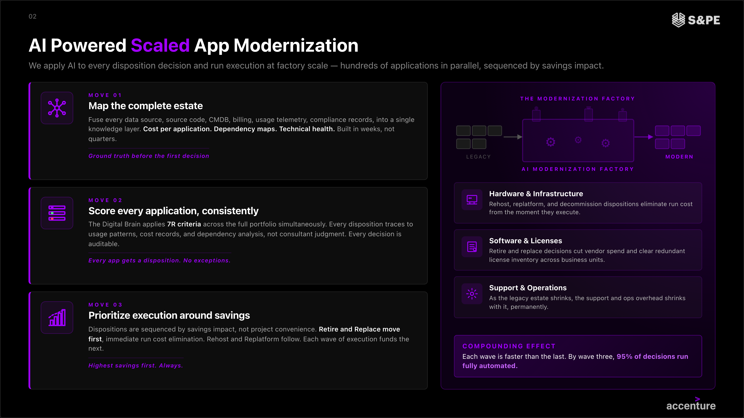
SOFTWARE & PLATFORM ENGINEERING PORTFOLIO OVERVIEW
AI Powered Scaled Application Modernization
Copyright © 2026 Accenture. All rights reserved. | Material, Non-Public - Not To Be Distributed Further
Notes:
ADD A VISUAL OF NUMBERS TO SHOW HOW IT’S SCALED OVERTIME AND THAT IT GOES FASTER BECAUSE OF THE KNOWLEDGE COMPOUNDING

Slide 30
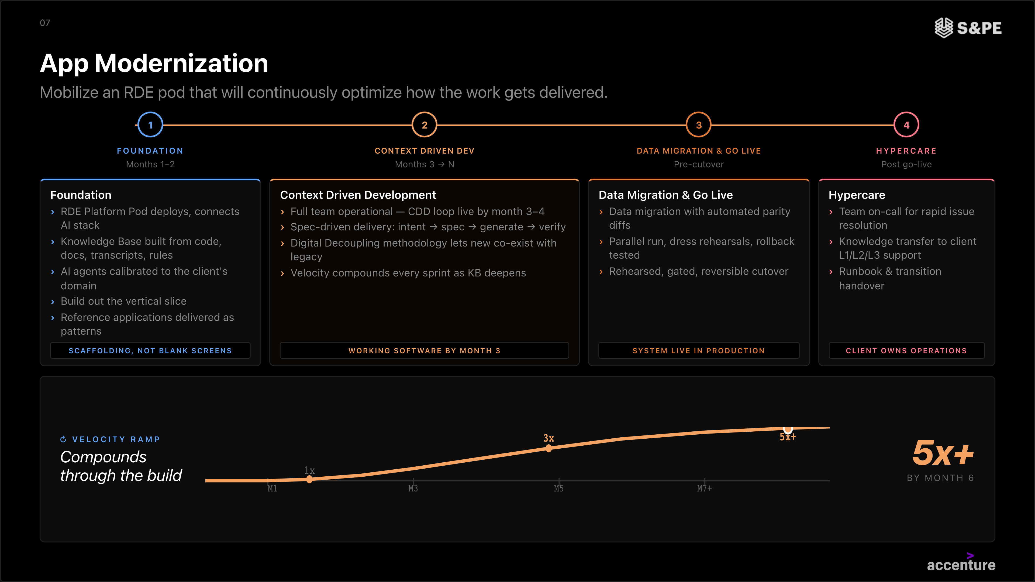
SOFTWARE & PLATFORM ENGINEERING PORTFOLIO OVERVIEW
AI Powered Legacy Modernization
Copyright © 2026 Accenture. All rights reserved. | Material, Non-Public - Not To Be Distributed Further

Slide 31
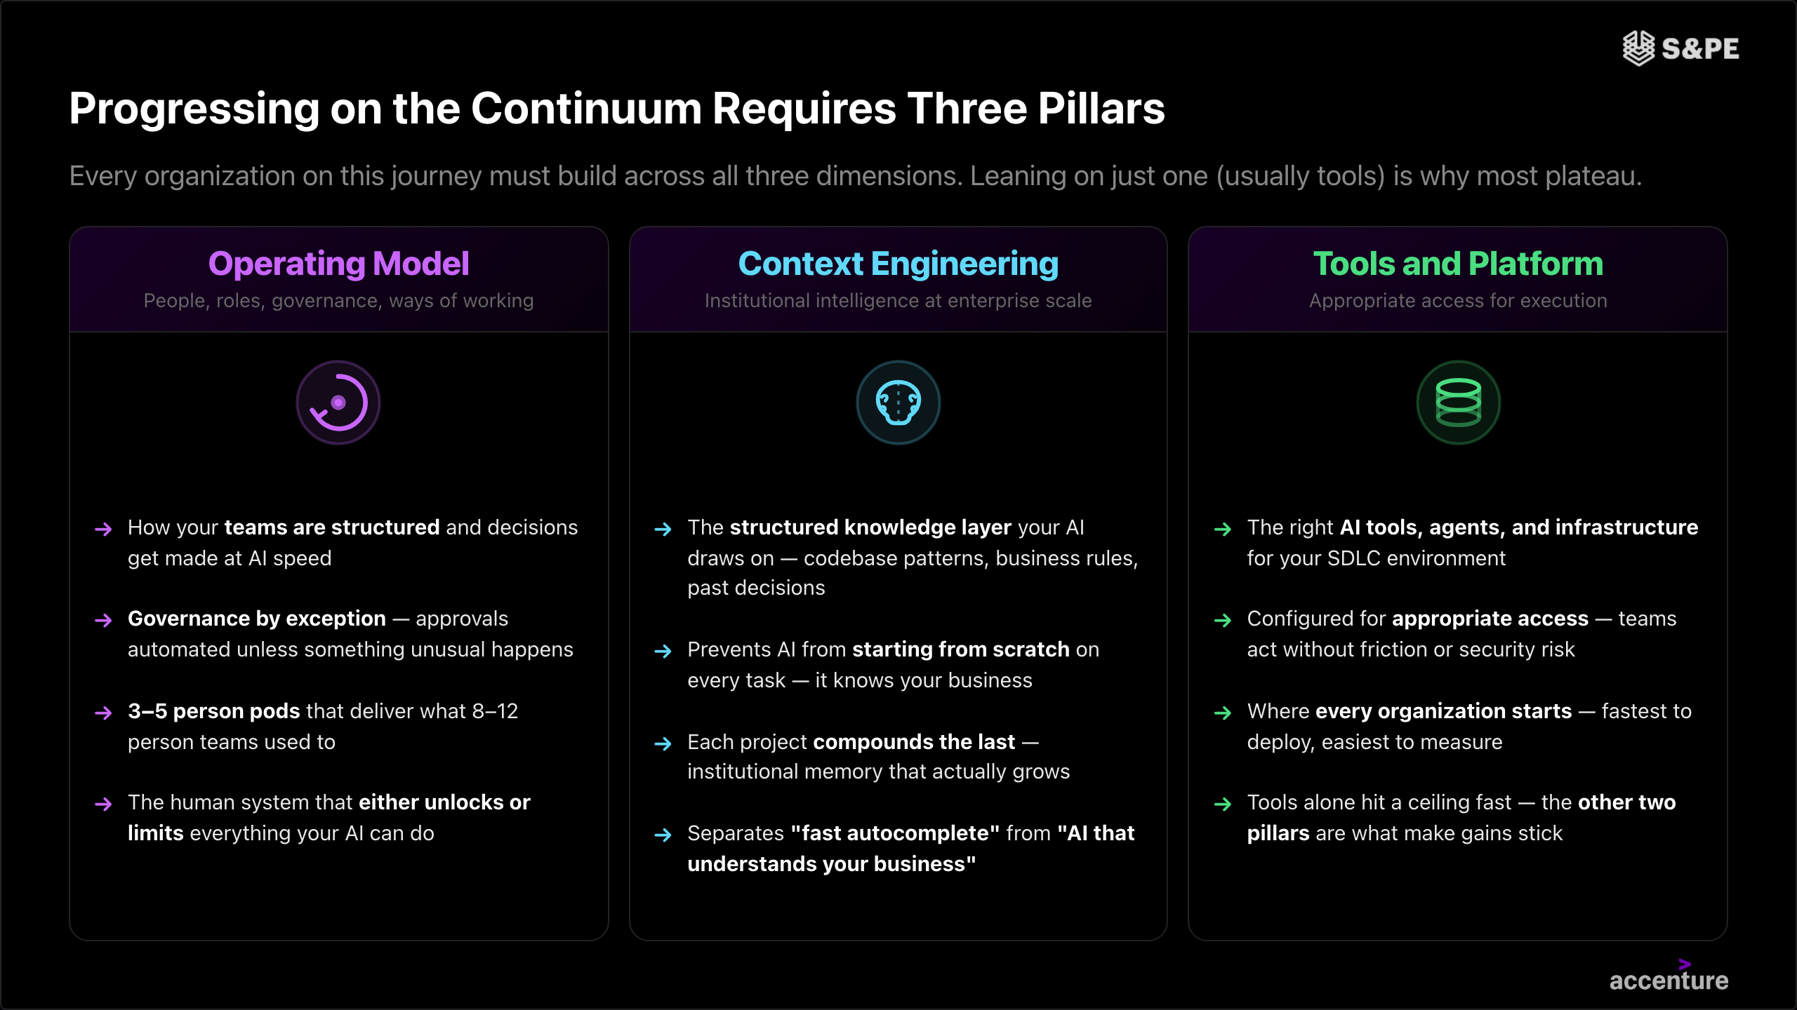

Slide 32
SOFTWARE & PLATFORM ENGINEERING PORTFOLIO OVERVIEW
The AI-Native Enhancement Engine
How we transform effort-based delivery into autonomous, AI-powered operations — with human oversight at every step
THEN — Traditional
Manual, effort-based
NOW — AI-Native
Autonomous, insight-driven
Backlog
1
Insights-driven Demand
AI surfaces the highest-impact enhancements from production data, telemetry, and support patterns — before clients even ask
Human in the loop
Prioritize & Validate Demand
Engineers validate AI-surfaced priorities against business goals and approve the demand backlog
Analysis
2
AI Impact Analysis
Predicts risk, maps dependencies, and auto-generates implementation plans — reducing analysis time by up to 70%
Assess Impact & Approve Plan
Architects approve plans and set risk boundaries before any coding begins
Coding
3
AI-Assisted Coding
Agentic coding handles generation, refactoring, and optimization — engineers focus on architecture and design decisions
Code Review & Sign-Off
Senior engineers review, validate against standards, and approve before testing
Testing
4
AI-Generated Testing
Comprehensive test generation and full-stack regression — achieving broader coverage with fewer manual cycles
Validate Test Coverage
QA leads validate coverage completeness and approve execution results
Release & Fix
5
Continuous Learning & Optimization
Each cycle feeds operational intelligence back into the system — the platform gets smarter with every release
Approve Release & Learnings
Operations authorize releases and feed learnings into the next cycle

Slide 33
SOFTWARE & PLATFORM ENGINEERING PORTFOLIO OVERVIEW
Option 1
Legacy Modernization Example
Client Story.
Client
What we will do
Skills & Technology
ACN Business Impact
Solution
Accenture is the primary partner in most of the areas of the bank. We will have a central role, expanding our existing position, in
(1) driving the transformation end to end
(2) Transforming the SDLC to a GenAI SDLC. Doing this by building the GenAI SDLC Platform to standardize, gain quality and efficiency for more than 16.000 software engineers, from the requirements gathering to deployment and production phases.
(3) Build new core banking platform on microservices architecture
(4) applying AI in different domains to accelerate the delivery of software products and business agents.
As part of the strategy to accelerate the modernization of the application and data to the new Architecture (Technical and Data), we have positioned to modernize the legacy application and data platforms in most of the domains, leveraging Gen AI.
Skills
Gen AI Engineering, RDEs, Tech. Architecture, Strategy & Design
Digital / Full Stack Engineering
Cloud Native Engineering
Data Architecture & Engineering
Quality Engineering
Technology
Java / Python / Springboot
JavaScript / Micro-frontends
Web & mobile app dev.
RAG
Semantic Layers
Google, AWS
USD 52M Total Deal Volume
USD 30M SPE Deal Volume
Background
BBVA is a global banking group at the forefront of banking innovation. BBVA has invested heavily in cloud, digital, data and AI to reinvent their business, accelerating the time to market in offering new products, reduce costs and be recognized as the most innovative bank offering new products to customers.
Accenture’s has been supporting BBVA in this journey during the last years.
As part of the strategy to gain agility, quality and reduce cost, BBVA is partnering with Accenture to help in the current and new work for 2026.
Coding S&PE
SI: USD 12M [Cloud Mi, Appl Mo]
AMS: USD 18 [Appl Mo, QE, P&PE]
12 months
duration
MUs involved
IBERIA
Ecosystem Partners involved
AWS, Google, RedHat, IBM, Oracle

Slide 34


Iberia | Q3 Opportunity
Client
What we will do
Skills & Technology
ACN Business Impact
Solution
Accenture has been the key partner for retail and distribution businesses providing services for all the core areas: billing & Collections, customer management, sales platforms, etc.
AI SDLC Productivity:
A commitment to a 30% productivity improvement over 5 years, supported by the adoption of GenAI use cases in the SDLC.
Commercial model transformation:
The contract will completely transform from T&M to a value-based model, shifting from the current 80-20 ratio to a 20-80 over five years.
Expanding our approach:
Iberdrola is involved in a major modernization process. The client expects Accenture to help modernize its systems and evolve its architecture and servicess, all enabled by AI solutions.
Skills
Digital / Full Stack Engineering
Tech. Architecture, Strategy & Design
Quality Engineering
Resources Industry
Utilities
Technology
Java / Jabol (BluAge Framework)/ Angular
Oracle / plsql
Azure platforms
USD 126M Total Deal Volume
USD 107M SPE Deal Volume
Background
Iberdrola is a global leader in clean energy, grids and storage, and is a more solid, sustainable and diversified company than ever before.
World leader in renewable energy, including offshore wind
Accenture has been a key partner for Iberdrola’s growth and internationalization strategy, and contributing to position it as a world-class utility
Iberdrola is now engaged with the evolution and modernization of its systems, opening a window of opportunities for service modernization
Coding**
SI: USD 12M [xx]
AMS: USD 107M [FullStack, QE, TA]
Relevant Initiatives
5 years
duration
Modernization
Iberdrola is starting a full modernization program led by accenture with three main workstreams: (1) containerise AKS, modernize and secure applications, (2) upgrade Oracle to Autonomous ADB; (3) segregate both business areas, retail and distribution.
MUs involved
IBERIA
Ecosystem Partners involved
Azure, IBM, Oracle

Slide 35



UKI | Vodafone ‘Conversational (AI) Excellence‘
Client
What we will do
Skills & Technology
ACN Business Impact
Solution
Transition out of Legacy Conversational platform running on IBM Watson and launch the Agentic AI platform running on MS Azure
External Channel Agentic sales. To be able to successfully sell a product with ChatGPT
New digital conversational / Service assistant Team. Develop and & launch new journeys to increases cross-sale & Upsell
Building on this foundation, Vodafone expects to achieve the following:
First mover advantage benefits & brand differentiation
Better product discovery & relevancy through conversation
Autonomous sales & Reduced steps to sale
New Platform will remove legacy constraints enabling innovation
Skills
MS Azure SME
Data Engineer
AI / ML Engineer
Agent Developers / Prompt Engineers
Data Modelers
UI/UX engineers
​Technology
Microsoft Azure, APIM, Cosmos DB, Open AI, AI Foundry, Langfuse, Redis, Azure AI Search
Agentic / GenAI
Conversational AI; Agentic AI; ChatGPT sales enablement; Agentic Sales and Care.
USD 3.8M (Year1)
35.8% CCI%
Vodafone UK
Background
Vodafone UK is seeking a strategic outsourcing partner to manage and accelerate the delivery of Conversational AI experiences across all their digital touchpoints.
Vodafone currently is running a legacy IBM Watson based platform which uses rule based Chatbots service journeys. As part of this opportunity. Accenture will migrate / modernise the intelligence layer out from Legacy IBM Watson platform to a modern Agentic AI based Azure platform.
Vodafone is an existing client, and this is a soul source opportunity based on previous GenAI work done for Vodafone.
Coding**
SI: USD 3M; Con: USD 800K
1 Year (+ Optional 1 Year extension)
duration
Involved people from S&PE & Friends
MUs involved
UKI
Steven Carvalho
Mark Farbrace
Ecosystem Partners involved
Microsoft

Slide 36
UKI | Q3 Opportunity: Specsavers ‘Framing the Future’
Client
What we will do
Skills & Technology
ACN Business Impact
Solution
Service and Technology Transformation Specsavers through reframing our strategic partnership
Current Services : AMS for Legacy systems and IMS for Store Systems & Corporate Desktops
New Managed Services: Legacy Value stream optimisation, Optimised Digital Managed Services, Platform Engineering, Enterprise QE, Integrated command centre, & additional L1/L2 services. Smart Asset Management, Group Service Desk and Service Management, Integration Platform are addition scope service may be included
Transformation: Infrastructure modernisation, Data Platform, Service Platform, TDMO, Network Optimisation, Apps Modernisation, Finance & Supply chain transformations, Store-in-a-box, Marketing & Customer experience
GenAI Hub investment, build & operate
Deliver enhanced technology foundations, consistent global operations and optimisation all aligned with the need to drive down IT.
Skills
Java
Active MQ
mySQL
Adobe Campaign
​Technology
Oracle EBS
Oracle Middleware
Agentic / GenAI
GitHub Co-Pilot
GenWizard
USD 160M Total Deal Volume
Currently going through contracting phase, expected to sign during FY26 Q3)
35.8% CCI%
Background
Specsavers is a purpose-driven global optical and audiology business (founded 1984) with 2,815 stores, 46,000 employees, and £4.1bn in revenue. A long-standing Accenture client since 2011, the organisation launched a transformation programme to focus on building a future-ready technology core to enable sustainable growth, improving transformation capability while optimising technology cost to reinvest in innovation and reduce legacy risk.
The transformation agenda targets £10m savings in Year 1 while underpinning a 2030 ambition to deliver an end-to-end blended customer experience across in-store and digital channels. This will expand services and drive growth, with a goal to increase the customer base of 48 million by 50%.
Coding**
SI: USD 18M
5 years
duration
Involved people from S&PE & Friends
MUs involved
UKI
Antony Kaplan
Ecosystem Partners involved
Oracle, Microsoft

Slide 37

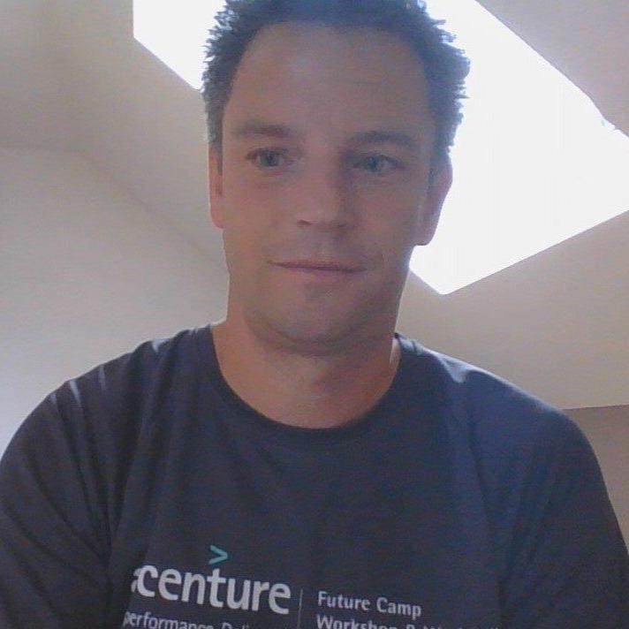

CEE | DB Systel GmbH - DBS/DBI #GP2 GenAI Migration (Closed Won FY26 Q2)
Client
What we will do
Skills & Technology
ACN Business Impact
Solution
DB has a lot of old custom-built software that is hard to maintain and should be migrated to a more modern solution.
Given the extent of the problem, Deutsche Bahn is eager to apply GenAI to facilitate these kind of migration tasks.
Scope of the deal is to build on the existing pilot and illustrate our GenAI-based migration capabilities on a broader scale.
Skills
Execute a reverse- and forward engineering for an existing legacy application (C++).
Implemented functionality of the service are extracted, user stories created, executable JAVA-Code, documentation and tests are generated
​Technology
Amazon Bedrock, Claude Code LLM (Sonet)
Agentic / GenAI
GenAI driven analysis​ of the legacy code & documentation
USD 236K Total Deal Volume
USD 236K SPE Deal Volume
30.0% CCI%
Background
    DB Systel GmbH, headquartered in Frankfurt am Main, is a wholly owned subsidiary of Deutsche Bahn AG and the driver of digitalisation for all Group companies.
    Digitalisation is the key factor in ensuring DB's future success.
    Cloud First: Over 450 processes and services migrated to the Deutsche Bahn cloud; over 535 terabytes of storage built into the cloud; flexible use of 7,000 - 15,000 virtual servers in the cloud
    DevOps: More than 170 teams with end-to-end responsibility for IT services
Why is it important?
Technical Blueprint for all our new RDE Story Projects.
The DBSystel Project itself has been two times extended by the
Customer cause of the well done execution.
Coding**
SI: USD 236K [MO]
4 months
duration
Involved people from S&PE & Friends
MUs involved
CEE
André Michael Leibe,
Florian Valentin
Ecosystem Partners involved
None
* S&PE Deal Types: T1 (Ownership): S&PE practice Incubates/Sells and Delivers | T2 (Delivery): S&PE practice Delivers | T3 (fractional): S&PE partial delivery
** AE: App Engineering | AR: Architecture | AT: Agile Transformation | Mi: App Migration | Mo: App Modernization | PM: Program & Project Management | QE: Quality Engineering | PPE: Product & Platform Engineering

Slide 38
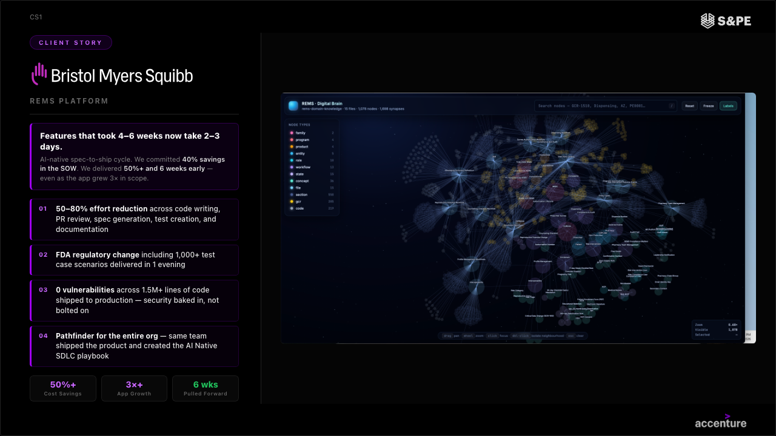

Slide 39
New Version
2026.05.13
Global Offering Lead: Ram Ramalingam
Digital Core Offering Domain
Software & Platform Engineering: Offering architecture L1-L4
Level 1: RP | Level 2: Offering Domain | Level 3: Sub Offering | Level 4: Solution
Digital Core | Software & Platform Engineering | High Velocity Modernization Modernize legacy systems using AI agents that analyze, refactor, and migrate code autonomously, delivering -native outcomes faster, cheaper, with significantly reduced execution risk | Application Modernization Mainframe Modernization
 |  | Frictionless SDLC Transform software delivery by embedding AI across workflows, automating tasks and building AI-powered SDLC and DevOps pipelines to increase productivity eliminating engineering friction | AI SDLC Reinvention AI Ops Enablement
 |  | AI-Native Custom Engineering Rapidly design and deliver custom applications, platforms, agents and integrations end-to-end, including SaaS replacement and Silicon solutions, eliminating licensing costs and vendor lock-in | Custom Application Development SaaS & Package Replacement Product & Platform Engineering Silicon Engineering Quality Engineering
 |  | Software Architecture Foundation Design and implement enterprise, technology and agentic architectures, including resilient and sovereign foundations, enabling scalable, future-ready, aligned, effective and built to last systems | Enterprise Architecture Technology Architecture Agentic Architecture Enterprise & Application Integration Sovereign Architecture
 |  | Software & Platform Engineering Managed Services Provide Application Managed Services across all Custom Software and Platform stacks, leveraging Agentic technology to enable systems to detect, diagnose, and resolve issues proactively, reduce toil and improve reliability and delivery speed | Custom Application Dev. Managed Services Mainframe Application Managed Services Product & Platform Managed Services Silicon Engineering Managed Services Quality Engineering Managed Services
Note: This is not an exhaustive list and will continue to evolve.
Internal Use Only
39

Slide 40
Old Version
Digital Core Offering Domain
Global Offering Lead: Ram Ramalingam
Software & Platform Engineering: Offering architecture L1-L4
Level 1: RP | Level 2: Offering Domain | Level 3: Sub Offering | Level 4: Solution
Digital Core | Software & Platform Engineering | High Velocity Modernization Modernize legacy systems using AI agents that analyze, refactor, and migrate code autonomously, delivering -native outcomes faster, cheaper, with significantly reduced execution risk | Application Modernization Mainframe Modernization
 |  | Frictionless SDLC Transform software delivery by embedding AI across workflows, automating tasks and building AI-powered SDLC and DevOps pipelines to increase productivity eliminating engineering friction | AI SDLC Reinvention AI DevOps Enablement
 |  | AI-Native Custom Engineering Rapidly design and deliver custom applications, platforms, agents and integrations end-to-end, including SaaS replacement and Silicon solutions, eliminating licensing costs and vendor lock-in | Custom Application Development Product & Platform Engineering Silicon Engineering SaaS & Package Replacement Enterprise & Application Integration
 |  | Autonomous Engineering Operations Implement autonomous engineering operations, SRE and Quality Engineering, enabling systems to detect, diagnose, and resolve issues proactively, reduce toil and improve reliability and delivery speed | Site Reliability Engineering Autonomous Engineering Operations Enablement Quality Engineering
 |  | Software Architecture Foundation Design and implement enterprise, technology and agentic architectures, including resilient and sovereign foundations, enabling scalable, future-ready, aligned, effective and built to last systems | Enterprise Architecture Technology Architecture Agentic Architecture Digitally Resilient & Sovereign Architecture
Note: This is not an exhaustive list and will continue to evolve.
Internal Use Only
40

Slide 41
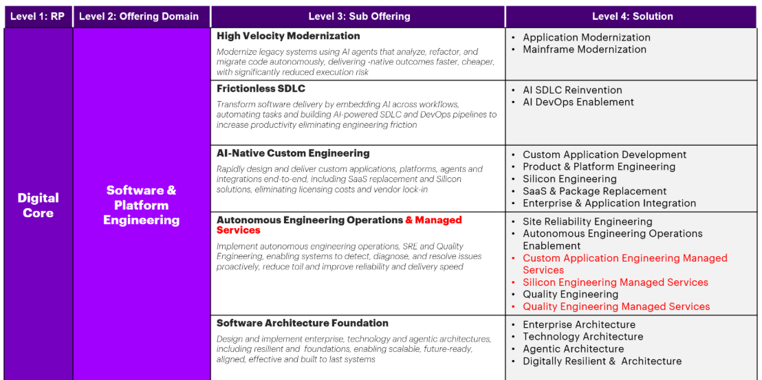
AMS Silicon is missing include it in red Same with Mainframe.
Custom Application Developmet Managed SErvices include it the top bucket.
AMS AM with MRS.
Fourth line change
#4 change in a new versión S&P Engineering Managed services
Include the 5 AMS services.
Replace AIOps Enablement to replace Automous Engineering operation and move it to Software Architecture foundation.
Make QE Move it to Custom Eng.
Digitally Resilient & Architecture check with Ezio.
Global Offering Lead: Ram Ramalingam
Note: This is not an exhaustive list and will continue to evolve.
Internal Use Only
41

